Slide 1







X
KIMIA FARMA BUSINESS PERFORMANCE
2020 - 2023
KIMIA FARMA - BIG DATA ANALYTICS
presented by Nabila Ijtihatil Ismail

Slide 2
X
Content
01
ABOUT ME
02
ABOUT COMPANY
03
ABOUT PROJECT
04
IMPORTING DATASET TO BIGQUERY
05
TABEL ANALISA
06
BIGQUERY SYNTAX
07
DASHBOARD PERFORMANCE ANALYTICS

Slide 3


X
About Me
My name is Nabila Ijtihatil Ismail. I graduated from the Bachelor of Agriculture, Agribusiness study program at Brawijaya University in July 2021. I have an interest in working with Data. I've honed my skills using Data Analysis and Data Visualization tools such as SQL, Bigquery, Tableau, and PowerBI.

Slide 4

About Company
PT Kimia Farma tbk merupakan perusahaan industri farmasi pertama di Indonesia. Didirikan pada tahun 1817 oleh Pemerintah Hindia Belanda, dengan nama NV Chemicalien Handle Rathkamp & Co. Berbekal pengalaman selama puluhan tahun, Kimia Farma telah berkembang menjadi perusahaan pelayanan kesehatan terintegrasi di Indonesia.
VISI
Menjadi perusahaan Healthcare pilihan utama yang terintegrasi dan menghasilkan nilai yang berkesinambungan
MISI
1. Melakukan aktivitas usaha di bidang-bidang industri kimia dan farmasi, perdagangan dan jaringan distribusi, ritel farmasi dan layanan kesehatan serta optimalisasi aset.
2. Mengelola perusahaan secara Good Corporate Governance dan operational excellence didukung oleh SDM profesional.
3. Memberikan nilai tambah dan manfaat bagi seluruh stakeholder.

Slide 5
X
About Project
This project aims to evaluate Kimia Farma's business performance from 2020 to 2023. There are four tables provided: the final transaction table, the inventory table, the kantor cabang table, and the product table. In this project, I will create an analysis table using BigQuery. The analysis table should include: transaction_id, date, branch_id, branch_name, kota, provinsi, rating_cabang, customer_name, product_id, product_name, actual_price, discount_percentage, persentase_gross laba, nett_sales, nett_profit, and rating_transaksi. The persentase gross laba should follow this rule:
Price <= Rp 50.000 -> laba 10%
Price > Rp 50.000 - 100.000 -> laba 15%
Price > Rp 100.000 - 300.000 -> laba 20%
Price > Rp 300.000 - 500.000 -> laba 25%
Price > Rp 500.000 -> laba 30%,
Then create a Performance Analytics Dashboard using Tableau. The dashboard should include:
Comparison of Kimia Farma's revenue from year to year
Top 10 provincial branches by total transactions
Top 10 provincial branches by nett sales
Top 5 branches with the highest ratings but the lowest transaction ratings
Total profit for each province

Slide 6
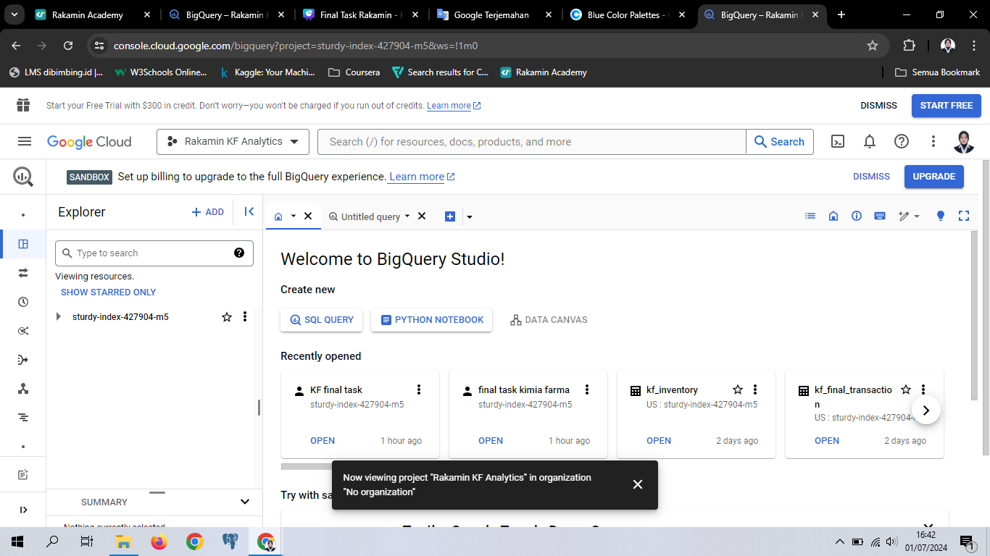
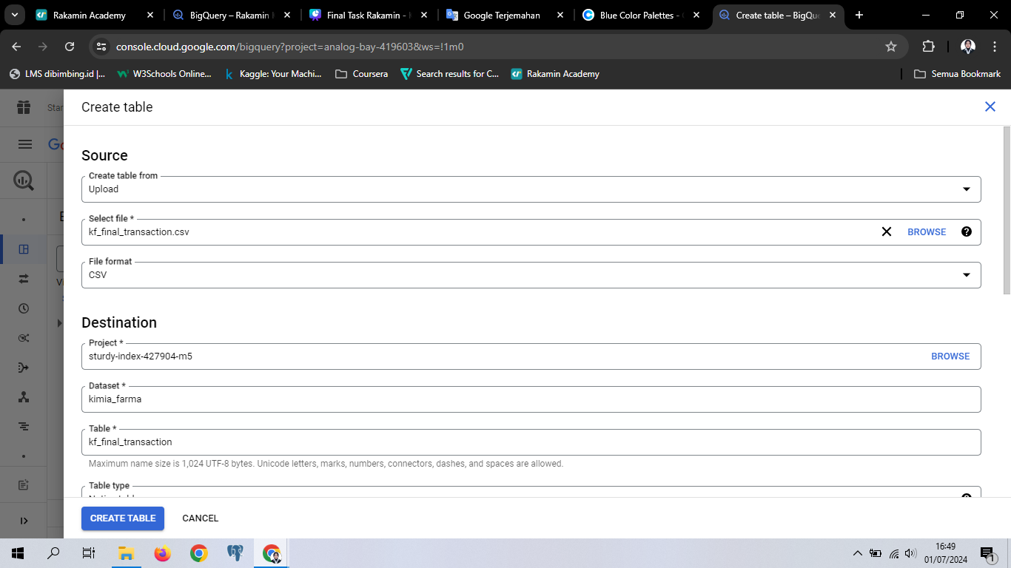
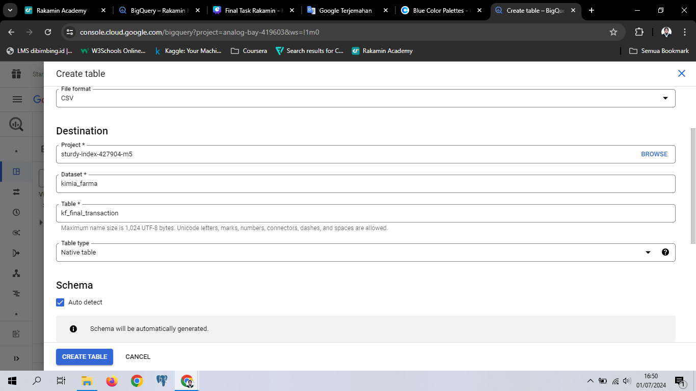

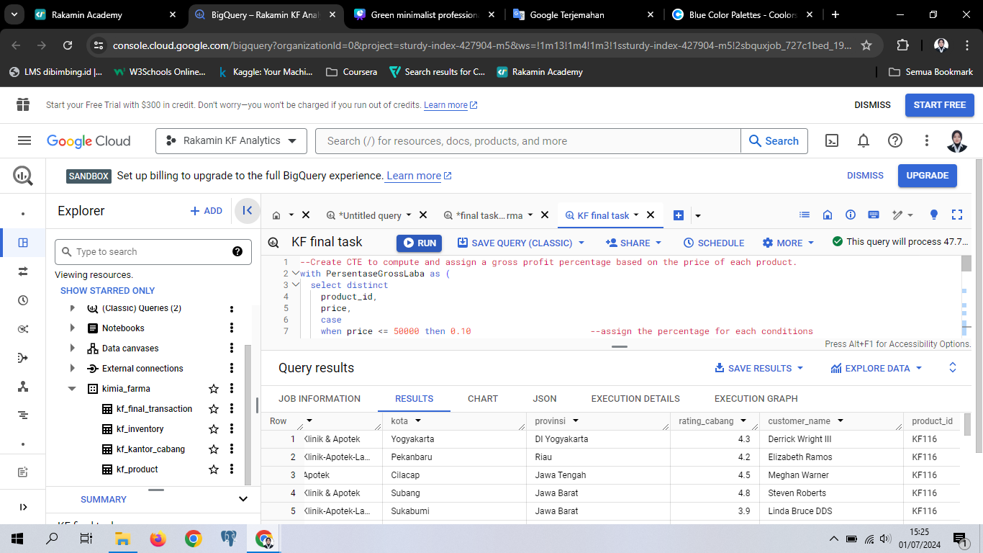
X
Importing Dataset to BigQuery
3. select the target project, then create a new dataset called kimia_farma and create a table name according to the file name without including .csv
Click ADD in the Google Cloud console then select Local File
2. Select the file you want to import
4. click the auto detect then click create table
result
The four tables have been imported properly into the Kimia_Farma dataset

Slide 7
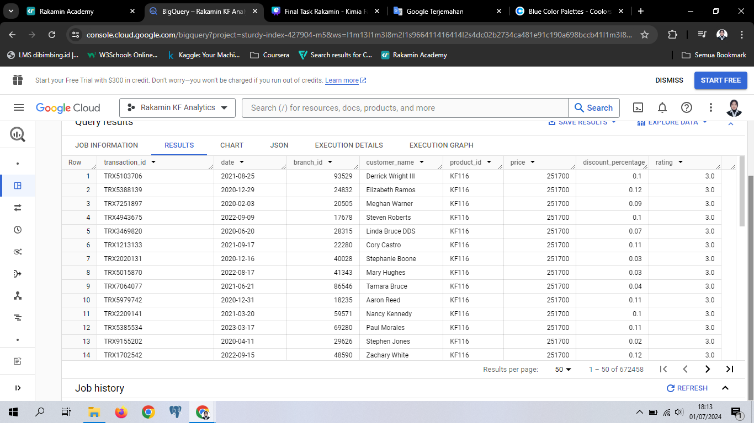
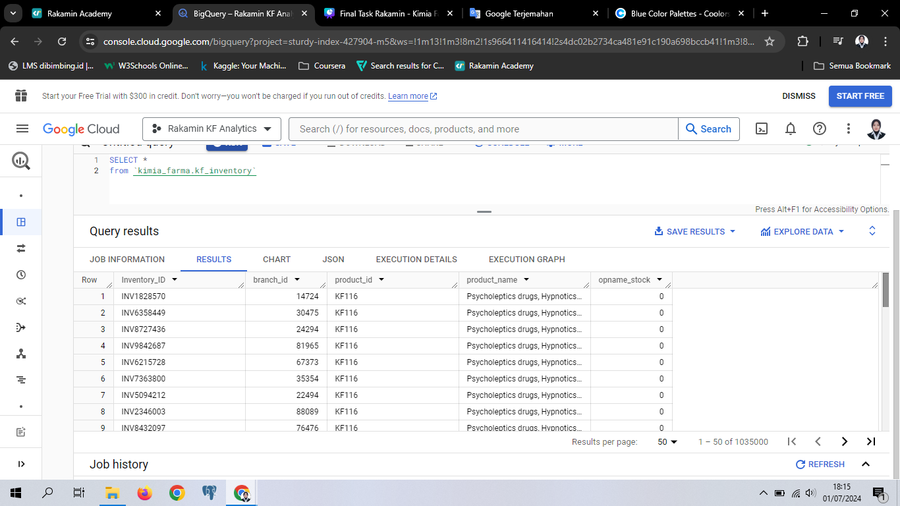
TABLE PREVIEW
X
FINAL TRANSACTION TABLE
INVENTORY TABLE

Slide 8
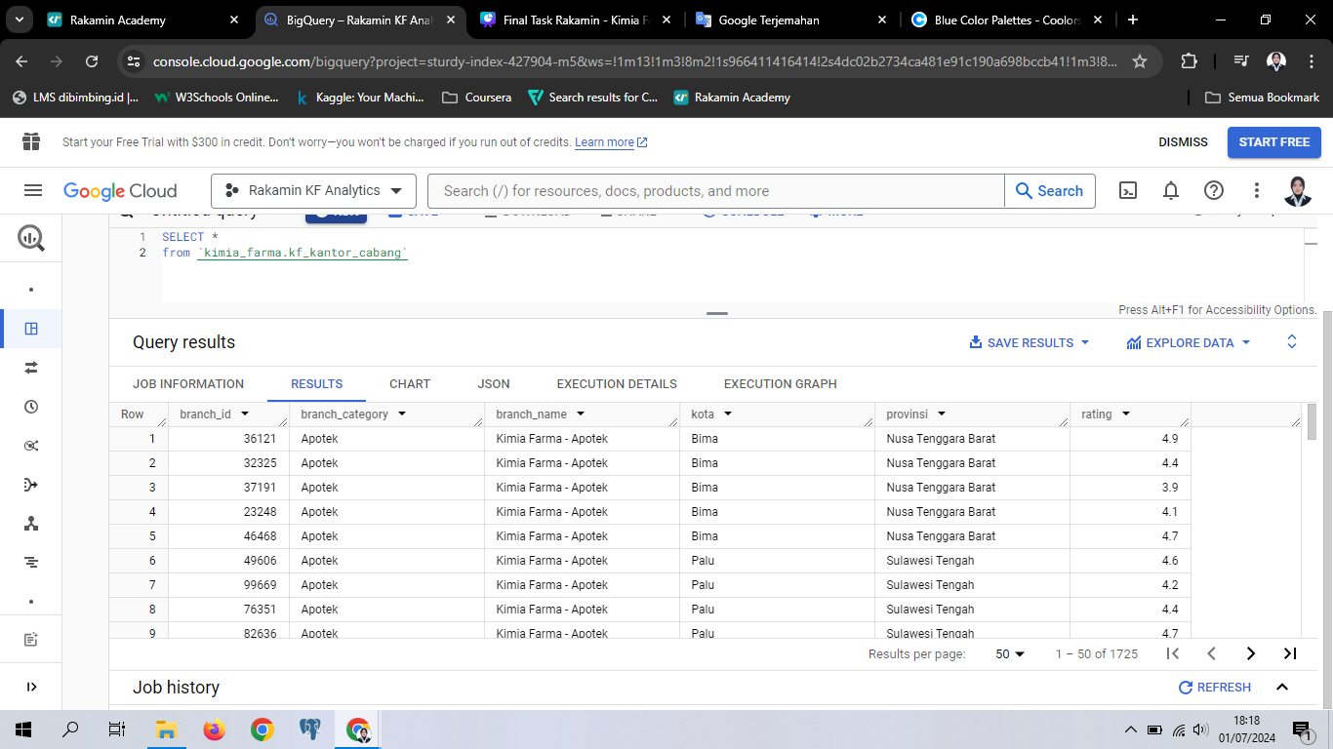
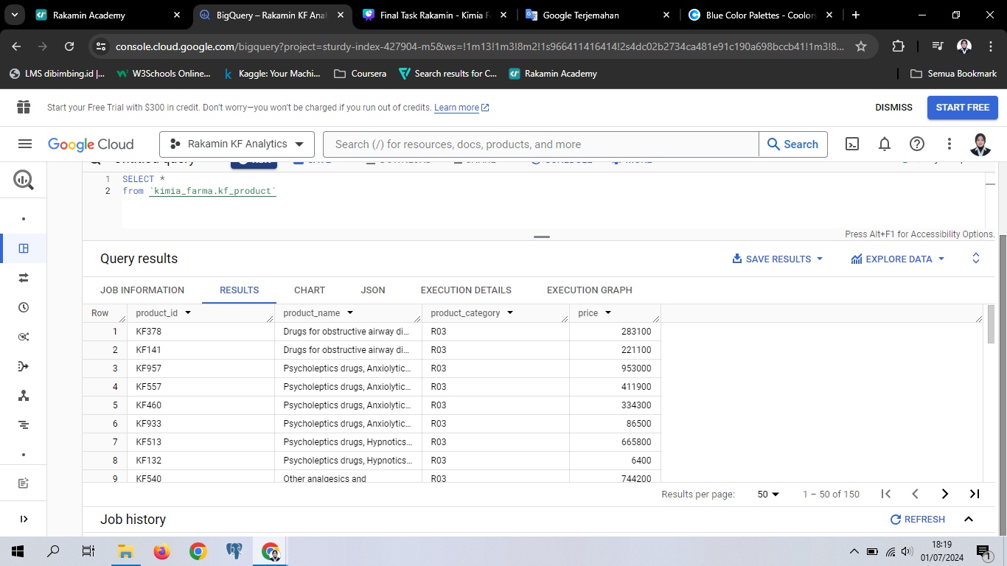
TABLE PREVIEW
X
KANTOR CABANG TABLE
PRODUCT TABLE

Slide 9

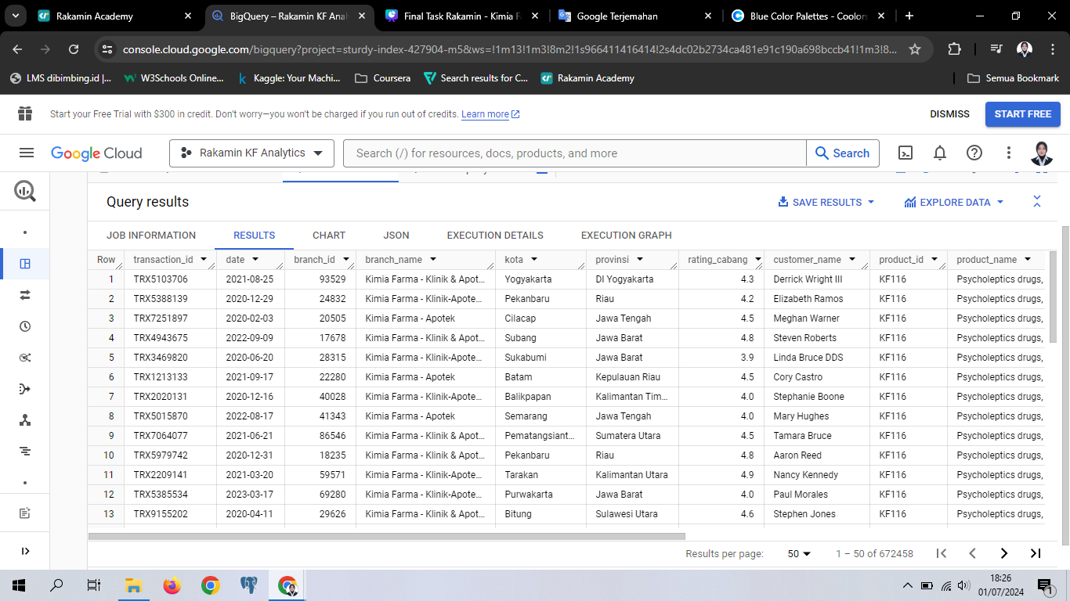
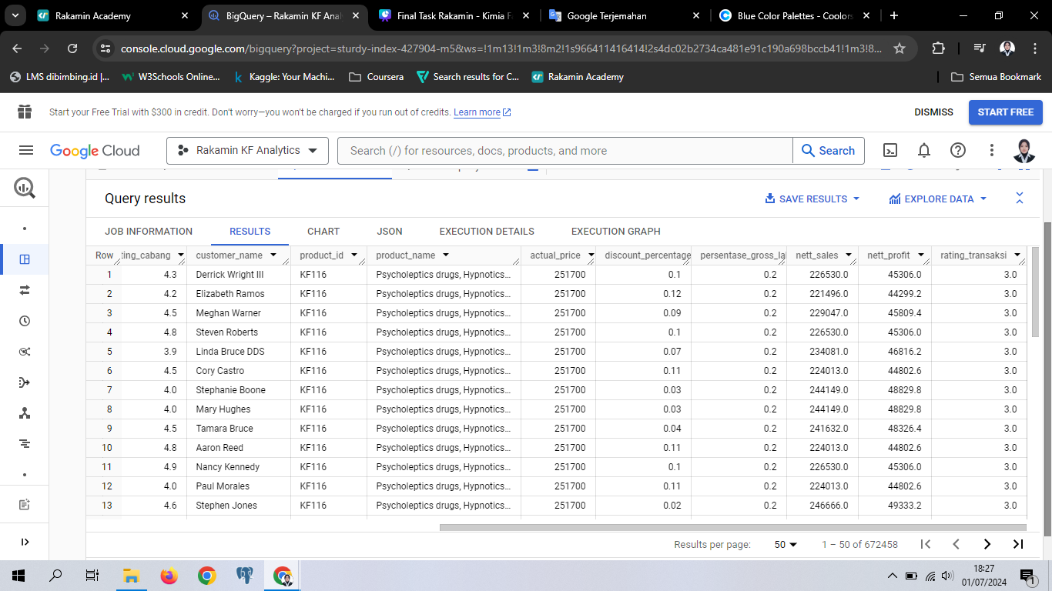
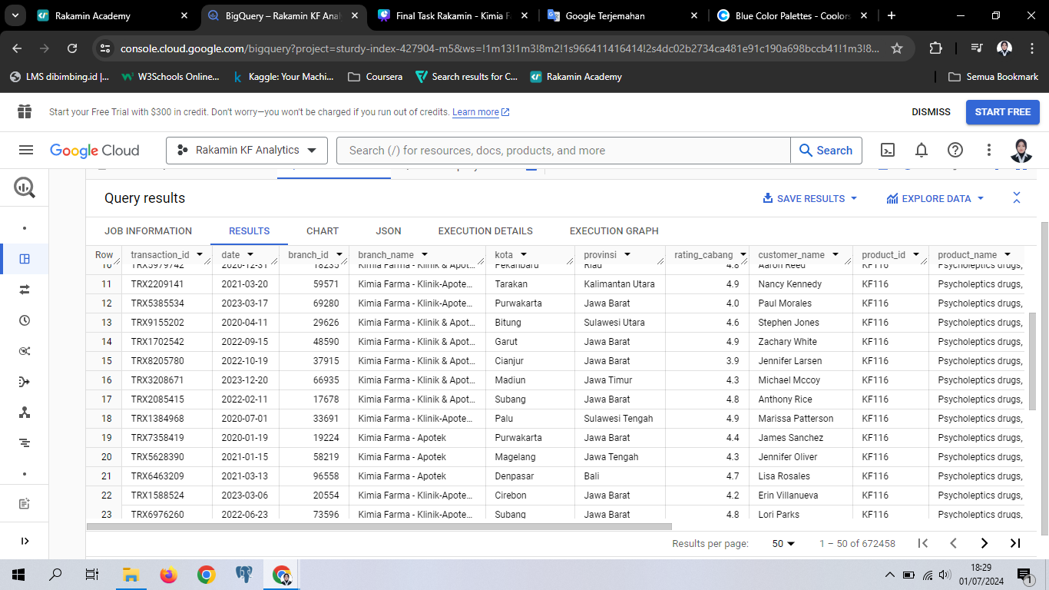
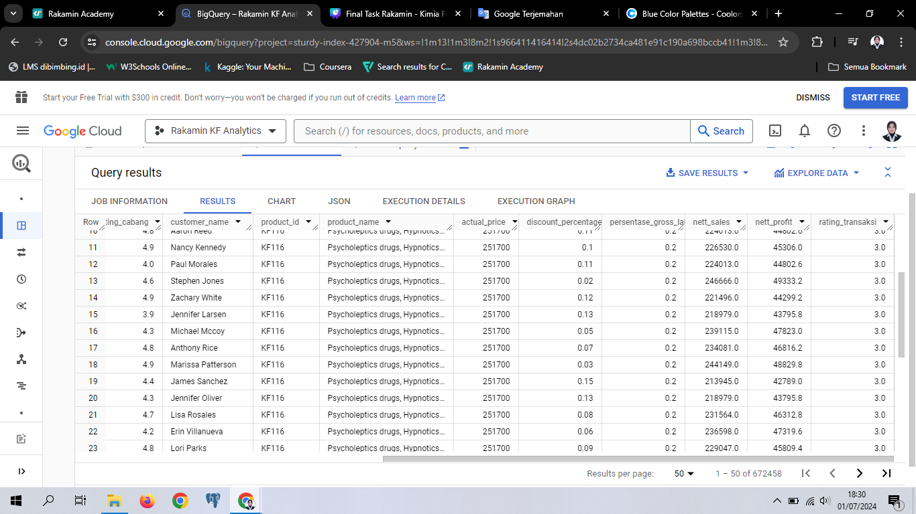
Tabel Analisa
the result of a query that has been executed

Slide 10
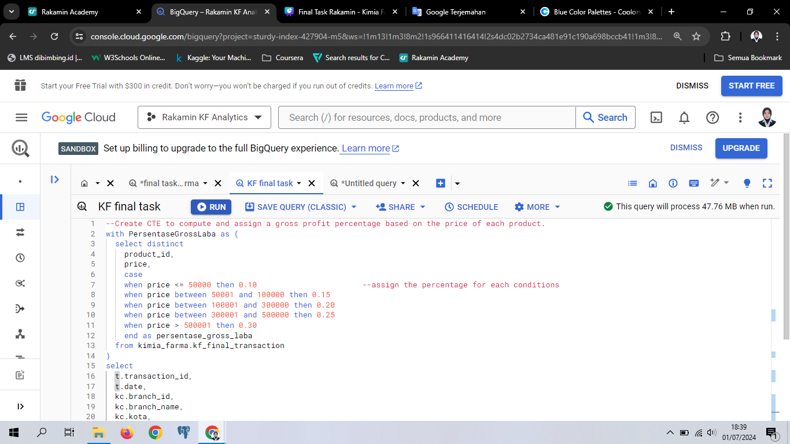
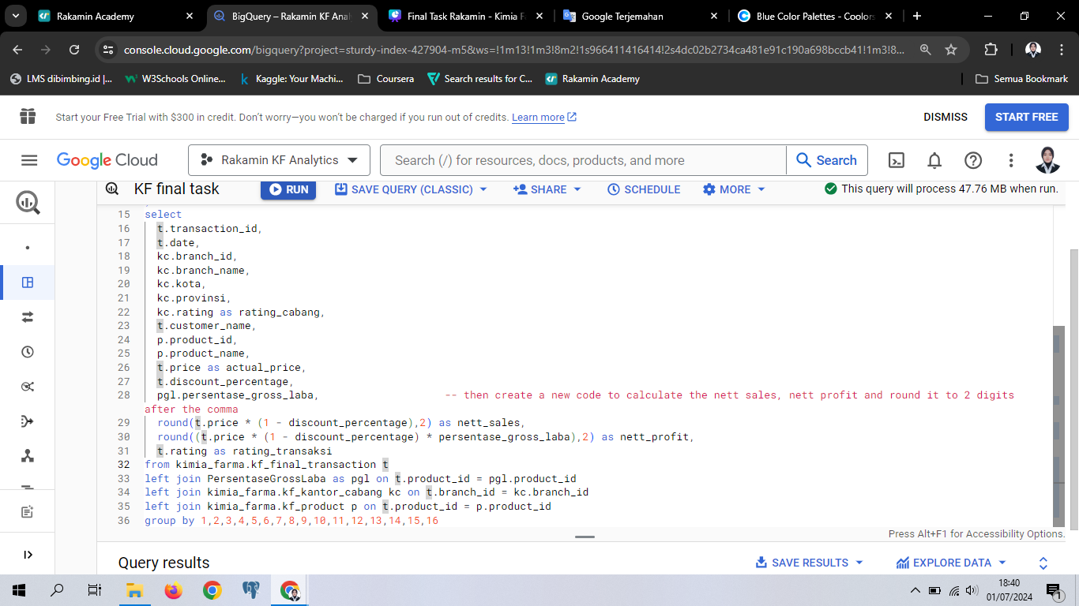
BigQuery Syntax
see the syntax here!

Slide 11
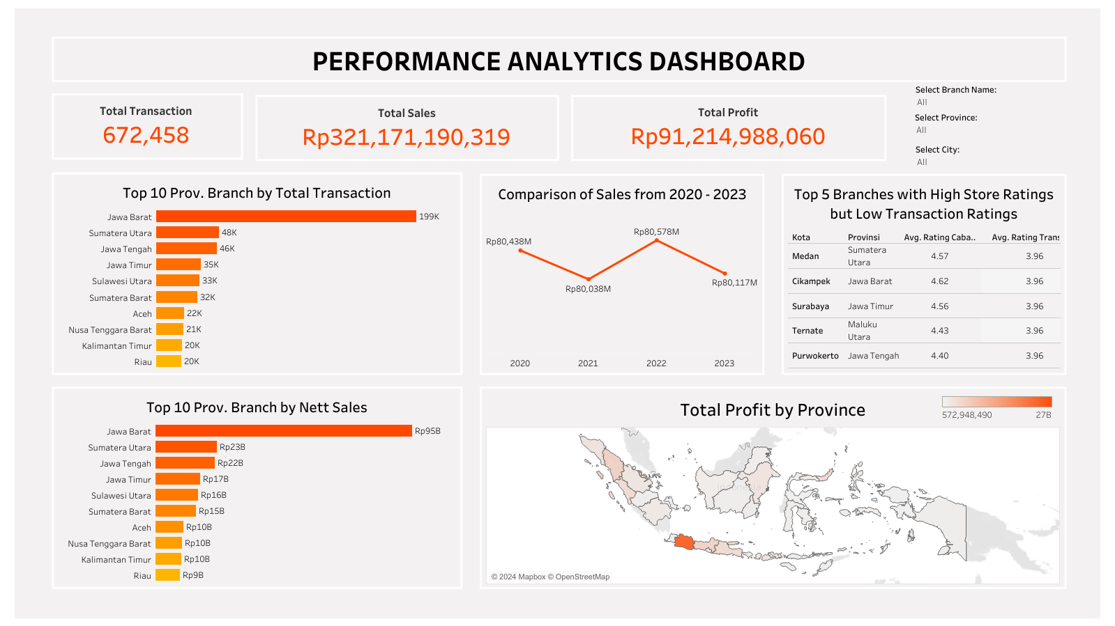
see tableau dashboard here!

Slide 12



THANK YOU
Nabila Ijtihatil Ismail
nabila.ijtihatil@gmail.com
www.linkedin.com/in/nabila-ijtihatil-ismail/

